Slide 1
Optimization Algorithms
BY:
AYUSH SINGLA (20074008)
NITIN (20075061)

Slide 2
Battle Royale Optimization Algorithm
Inspired from battle royale video games like PUBG, Apex Legends, CSGO in which game area shrinks and player fight to survive with limited resources.
Shrinking game area is key feature of BRO which causes candidate solutions (players) to compete with each other.
Steps in BRO algorithm are given below:
Initialize a random population.
Compare i^{th} player with j^{th} player.
Dam = damaged player index, vic = other victorious player.
If damaged player index is greater than threshold then respawn it randomly in game area.
Else increase damage by 1 and move it randomly towards current best position.
Decrease game area after each iteration.

Slide 3
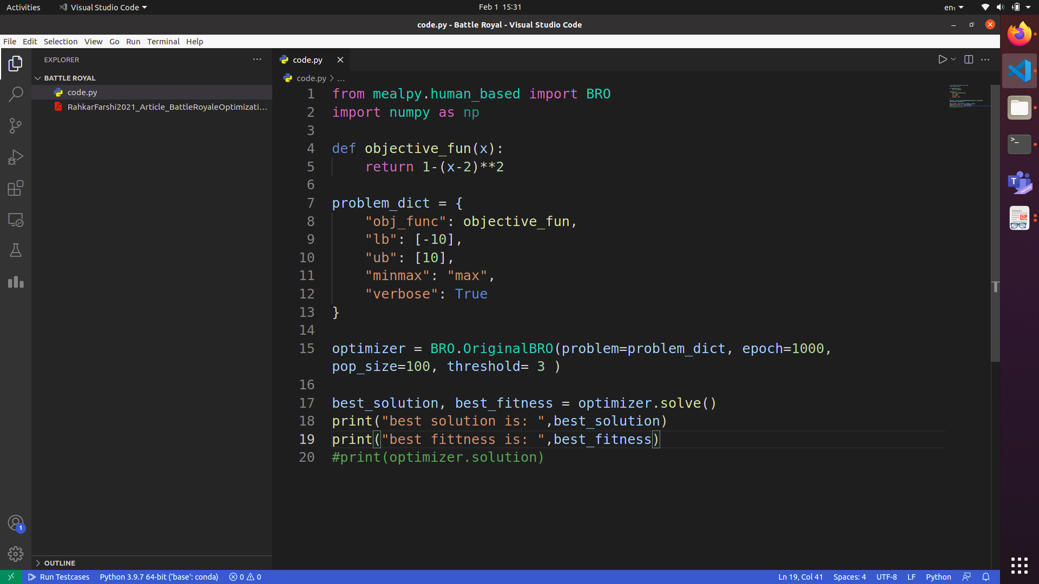
Battle Royale Optimization Algorithm Contd.
Code for BRO using mealpy python package:

Slide 4
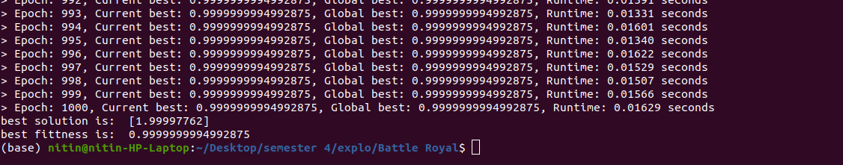
Battle Royale Optimization Algorithm Contd.
Output:

Slide 5
Artificial Bee colony Algorithm
Generate a random population of food sources.
Employed bee phase:
Employed bees look for better food source in vicinity of parent food source based on the fitness value of the new food source.
Onlooker bee phase:
Onlooker bees go to the suggested sites given by employed bees, the higher the chance the greater is the probability for selection.
Scout bee phase:
If a food source is not changed after certain iterations, then that food source is considered to be exhausted and employed bees becomes scout and search randomly for a new food source between lower and upper bound.
Memorize the best solution.

Slide 6
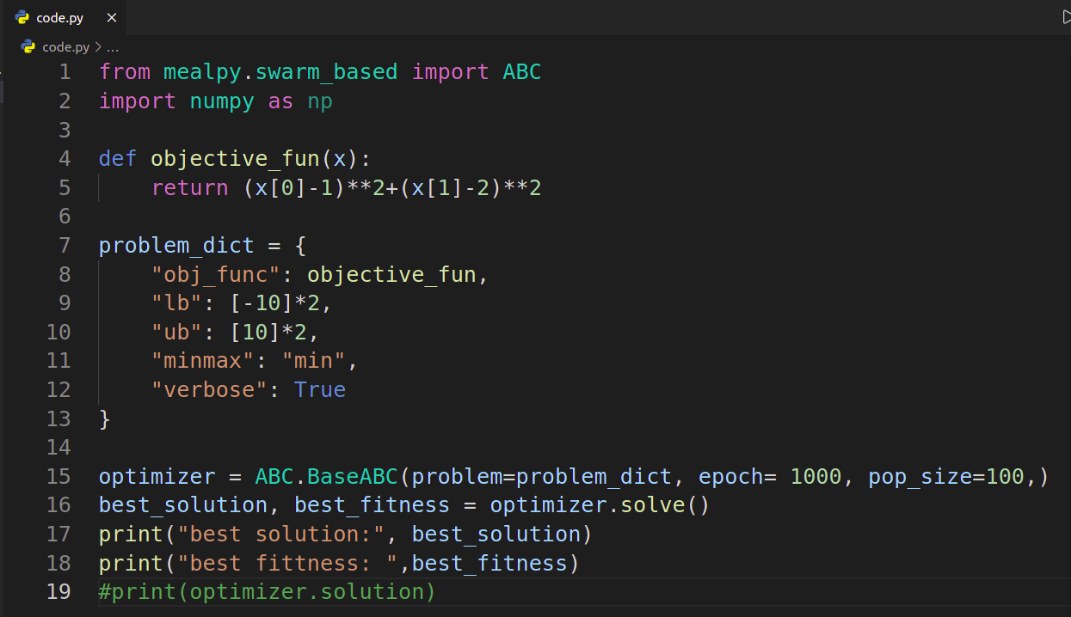
Artificial Bee colony Algorithm Contd.
Code for ABC using mealpy python package:

Slide 7
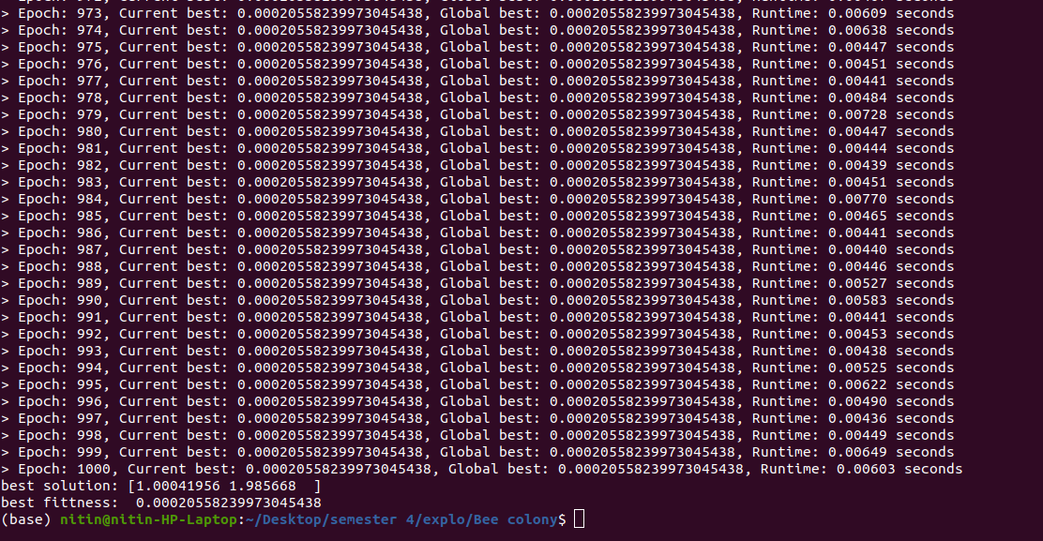
Artificial Bee colony Algorithm Contd.
Output:

